Slide 1
WHCCD Infobook Dashboard
Office of Accreditation, Institutional Research, Effectiveness, and Planning

Slide 2
Session Learning Outcomes
Participants will understand how to…
Locate the dashboard
Access different levels of location data
Download the dashboard as a PDF
Interpret frequently asked research questions into retrievable data points

Slide 3
Background
There are a few public-facing sources of data
CCCCO via MIS
Datamart
Student Success Metrics via Cal-PASS Plus
IPEDS
Old Institutional Data/Factbook PDFs…
These are often broad and miss some of the nuance of current practices and specific local practices
Special Admit Students
Multi-college district with a center
Substantial online instruction
Identified the need to see the district/colleges at a glance
Dataset that is pre-aggregated and masked for FERPA
Minimal filtering
Updated underlying data to use the WHCCD Data Warehouse which accounts for current practices

Slide 4
Scenario Prompts
Answering frequent questions…
The unduplicated headcount for WHC Lemoore for the most recent year?
What percent of Coalinga enrollment is dual enrolled?
Has the number of male students decreased over the past three years for Lemoore Campus?
Has course success increased over the past five years for Coalinga Online?
What are the top 10 programs by the number of grads in 2020?
What are the top 10 transfer destinations in 2019?
Where do NDC students live?
How many students in the district reside in Huron?
Do online students reside in the district?
How do you define/measure these things?

Slide 5
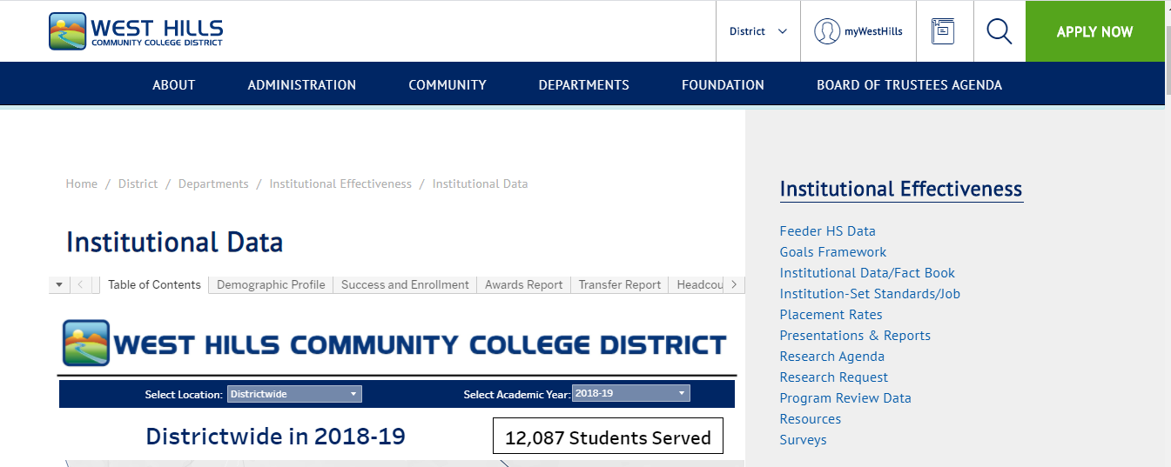
Where is it?
https://westhillscollege.com/district/departments/institutional-effectiveness/institutional-data.php

Slide 6
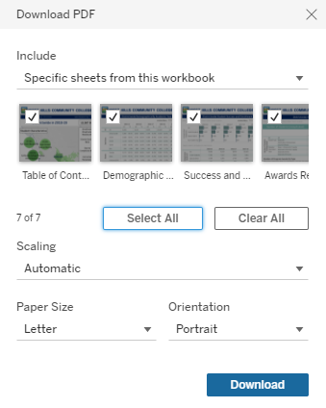
Options to download a PDF
Select the location of interest
Select the academic year of interest
Scroll down for the download option
Click dropdown under “Include” and change to Specific sheets from this workbook
Then click Select All
Click Download

Slide 7
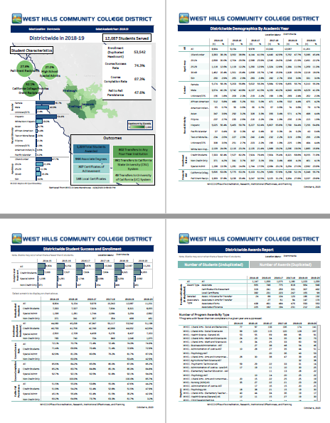
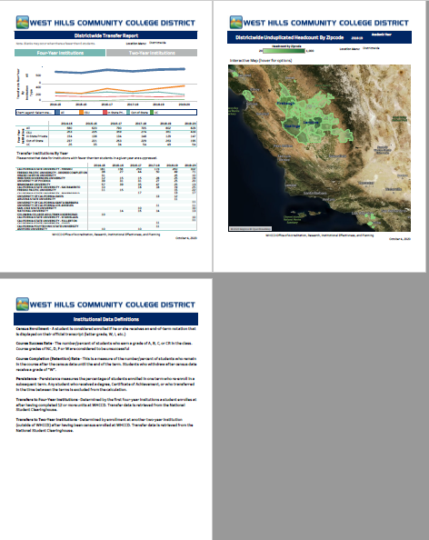
Factbook as a PDF Doc

Slide 8
Limitations
Term-by-term is not available
Current academic year data is not available
Disaggregations are limited
Beyond award counts, program-level data is not available
Data is a snapshot of each year
Includes awards and transfer counts but not rates
Small numbers of students at certain locations may mean the Table of Contents is blank on certain years due to FERPA masking

Slide 9
Bonus
Want to build your own viz? Or just need to copy/paste the numbers?
Pre-aggregated dataset is available here: https://my.whccd.edu/whccd-public/Reports/WHCCD_INFOBOOK_DATASOURCE.csv

